Slide 1
CHINESE CULTURAL TIPS

Slide 2
CHINA IS SIMPLY OVERWHELMING

Slide 3
Outsider
Chinese have an great sense of superiority. It is so obvious to them, needs hardly to be emphasised.
Cant imagine a non sino centric world. “ Tian Xia”.
Da bizi, Yang ren, Yi.
Lao wai is the best you can hope for.
No concept of Equal, Brother.
Bowing.
Seating Plan during meetings.
Ordinary Chinese have no Idea India considers them as an adversary. Awara Hun.

Slide 4
Outsider
Beware of the Barbarian who can speak Chinese. Banned.
Mark Zuckerberg.
Superficially Friendly. Every Visit is a show.
Even our maid Wong held us in contempt initially.
English is just Background noise.

Slide 5
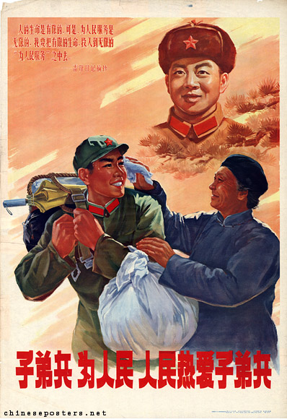
OTHER POINTS
Sense of Collective…. No concept of Individual Heroism (Combat, Olympic
Medals etc). Decisions made by a Committee.
The Honour belongs to the group, not the individual.
A Hero is a person who does his daily duties diligently.
“ Learn from Lei Feng”. (5 March)
Selflessness.
Modesty.
Devotion to Mao Ze Dong.
Father killed by the Japanese, Lei Feng was killed by an
Army Truck hitting a telephone pole, which fell on him, age 21.

Slide 6
Obedience and Self Discipline always emphasised.
(right from birth).

Slide 7
PUNCTUALITY
BE PUNCTUAL.
If it is an important meeting and they think you will be late, they will send a pick up and LO.
If you are late, that is the END.
Expect that Guests will land up around 30 minutes before.
The Guest of Honour will arrive bang on time, but his SO will reach early.
The Guest of Honour will leave early as a sign of his importance. Similarly you must leave early too (tip: see end Timing in the card)

Slide 8
Face
Mian zi. Dui bu qi etc
2008 Summer Olympics. Lin Miaoke
https://www.youtube.com/watch?v=05E-9Yu9EJ4
2009 PLA PARADE.
https://www.youtube.com/watch?v=zzP5qr-ZxHY

Slide 9
Shanzhai
Bandit.
Water Margin/ Outlaws of the Marsh and Romance of the three Kingdoms inspires
“ War on behalf of common people is good”.

Slide 10

KNOCK OFF DVDs

Slide 11
Guanxi
Blood is everything.
Contacts/ Network is everything. Favours are given, expected.
Being part of a network entitles you to certain rights and imposes obligations.
Hence achieving “understanding” is important before anything gets done.
Law has little meaning. Law is only a way to get done what has been decided.
That is how it has always been.
“Little Emperors”

Slide 12
Indirect Communication
Seating.
Walk into a room.
Pose for a group photo.
Cigarettes.
Process is more important than outcome.
Be Clear without being direct. Some knowledge of Proverbs etc useful.
Expect to be taken advantage of and guard against it.

Slide 13
Other Tips in Meetings
Seating plan.
Soft Handshake.
Eye contact not necessary. May deliberately avert their eyes. Not an indicator of honesty.
“ Last two minutes”. Don’t be impatient.
Lot of time spent in finding common ground.
Expect a Charm Offensive..

Slide 14
Meetings are like a Chinese meal
Looks great.
Tastes great.
But
After half an hour you are hungry again.

Slide 15
They will never say No, but will say…
It is not convenient.
We are embarrassed that our facilities are not ready for your visit/ your proposal yet.
if he is referring it to HQ, that’s not a No.
In fact, Proposals will always be sent up. May be frustrating at times.

Slide 16
Meals
Location. Banquetting is everything.
Sequence.
Seating Plan. Bring and distribute many business cards.
Knowledge of Cuisine, dishes and customs
Ganbei. Getting drunk is good form. My first reciprocal banquet!
Drinking Competitions.
Do not polish off your plate. But eat a little bit of everything
Use Chop sticks.
Paying the bill.
Er nai.
Chaguan.
For Formal Meals, there will be a start and an end time. Expect abrupt end to banquets.

Slide 17
Partying
Karaoke.
Bars.
Communist sense of Collective.
Common spaces.
Unlikely to be invited home. If you are, especially for Spring Festival family reunion, it is a great thing.
Gifts.

Slide 18
Gifts
Giving and taking visiting cards.
Packaging.
Opening, remarking on the item.
Do not try to out do them.
It is common to give gifts during different holidays and special occasions.
Chinese New Year, you should give red envelopes with money to children and staff.
During Mid-Autumn Festival, it is customary to give yue bing.
When someone has a new house, a fruit basket signifies wishes for good luck.
Please, no feng shui crap.

Slide 19
More General Points
More emphasis on Basic principles than specific issues.
“Spirit of the agreement” than “letter of the agreement”.
Will Avoid making incremental concessions. Come with a “ hard position”.
Come armed with history of the negotiations.
Prepared to wait you out. Think long etc.
Negotiation is not a closed thing after something is signed, signature is only part of the process. Try to get back ground yielded from the “ hard position”.

Slide 20
So.. What should we do
Prepare well.
Know your bottom line.
Be patient.
Take advantage of opportunities for informal discussions.
Send signals of dissatisfaction.
Be aware of intricacies of Chinese etiquette.
Finally ..dont be afraid to say No and return empty handed.

Slide 21
Women and Babies
Mao said- Women Hold up Half the Sky.
Extremely courteous to Women.
Violence almost unheard of.
But Gender Roles are very Clear, not to be criticized.
Mrs Wang is not Mr Wang’s wife!
Babies not to be petted. Babies don’t Cry.
No baby showers before birth. Gifts include padlocks, Zodiac in gold, Unshelled peanuts (Changshengguo).
Knowledge of names important.
Cash is a good gift. No clocks!!

Slide 22
Racism
Hilarious stereo types.
Puzzled as to why it is called racist.

Slide 23
Don’t Discuss
The Japanese.
Tiananmen.
Politics.
Tibet or the Dalai Lama.
Religion.
Party Leadership.
They have never heard of 1962 war.

Slide 24
Do Discuss
Chinese are fantastic with numbers. Everything is a combination of numbers.
Mildly test them.
Regional Cuisines.
Bollywood.

Slide 25
THANK YOU

